Slide 1
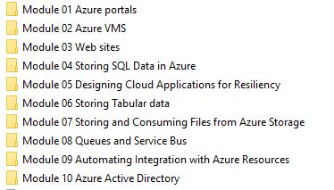

Slide 2
Module 1
Overview of the Microsoft Azure Platform
Notes:
This module is a recap of the Microsoft Azure services and features that students should already be familiar with before taking this course. The Azure Portals lesson ensures that all students, experienced or novice, have the same understanding of the Azure Portal.
20532C
1: Overview of the Microsoft Azure Platform

Slide 3
Module Overview
Azure Services Azure Portals
Notes:
20532C
1: Overview of the Microsoft Azure Platform

Slide 4
Lesson 1: Azure Services
Services Overview Websites Virtual Machines Cloud Services Storage SQL Database Virtual Networks App Services
Notes:
This lesson provides a brief recap of common Azure services. Don’t spend a lot of time on each service because the students are expected to have this knowledge as a pre-requisite for this course. It is important to check with your students that they have this experience. If not, take some time to bring them up to speed or suggest supplemental training.
20532C
1: Overview of the Microsoft Azure Platform

Slide 5
Services Overview
Microsoft Azure is a collection of services
Communication Infrastructure
Data Streaming and Storage
Web Hosting
Mobile Connectivity
Notes:
The following slides show the list of services and features that students should be familiar with before taking this course.
20532C
1: Overview of the Microsoft Azure Platform

Slide 6
Services Overview (cont.)
In a typical project, there are many Azure services to choose from:
MEDIA SERVICES
VIRTUAL MACHINES
SERVICE BUS
HDINSIGHT
VIRTUAL NETWORKS
MOBILE SERVICES
MACHINE LEARNING
ACTIVE IRECTORY
WEBSITES
STORAGE
DOCUMENTDB
SEARCH
EVENT HUBS
AUTOMATION
Notes:
20532C
1: Overview of the Microsoft Azure Platform

Slide 7
Services Overview (cont.)
You may only use a small subset of the available services:
MEDIA SERVICES
VIRTUAL MACHINES
SERVICE BUS
HDINSIGHT
VIRTUAL NETWORKS
MOBILE SERVICES
MACHINE LEARNING
ACTIVE IRECTORY
WEBSITES
STORAGE
DOCUMENTDB
SEARCH
EVENT HUBS
AUTOMATION
Notes:
20532C
1: Overview of the Microsoft Azure Platform

Slide 8
Services Overview (cont.)
You may only use a small subset of the available services:
In this course, you will learn about the services that you could use in your projects
MEDIA SERVICES
VIRTUAL MACHINES
SERVICE BUS
HDINSIGHT
VIRTUAL NETWORKS
MOBILE SERVICES
MACHINE LEARNING
ACTIVE IRECTORY
WEBSITES
STORAGE
DOCUMENTDB
SEARCH
EVENT HUBS
AUTOMATION
Notes:
20532C
1: Overview of the Microsoft Azure Platform

Slide 9
Websites
Azure Websites is a Platform-as-a-Service offering that allows you to quickly and easily deploy and scale up a web application.
Features:
Create a website instance from the gallery
Configure linked resources
Create and use hosting plans
Change between the Free, Shared, Basic, and Standard modes
Deploy from a source control provider
Notes:
20532C
1: Overview of the Microsoft Azure Platform

Slide 10
Virtual Machines
Infrastructure-as-a-Service offering that allows you to deploy compute instances in minutes to be used for Windows or Linux workloads.
Features:
Use images built by the product teams to deploy workloads such as SQL Server, SharePoint and Apache
Attach, format and configure multiple disks for a VM
Remotely connect to a Windows or Linux VM
Select between VM sizes (A0-A9)
Select a Basic or Standard tier VM
Notes:
It is important to remind the students that they don’t necessarily have to memorize the virtual machine sizes. They simply need to understand that there are multiple virtual machine sizes, and they need to keep in mind certain considerations while selecting a virtual machine size for their instance. They also should understand that the Basic and Standard tiers have slightly different performance levels for each size (IOPS typically).
Discussion Question: How do you remotely connect to a Windows–based virtual machine and a Linux–based virtual machine?
20532C
1: Overview of the Microsoft Azure Platform

Slide 11
Cloud Services
Cloud Services is a Platform-as-a-Service offering that allows you to focus on your application code while the Azure platform takes care of scaling up your application and making it highly available
Features:
Associate virtual machines with Cloud Services
Scale up an instance and configuring load balancing
Deploy an existing Cloud Service package
Notes:
At the entry level, it is not necessary for a student to understand how to create a cloud service and understand some of the advanced functionality. It is enough if they understand the relationship between Cloud Services and virtual machines.
20532C
1: Overview of the Microsoft Azure Platform

Slide 12
Storage
Reliable and scalable storage service for data of all types and sizes.
Features:
Select a datacenter for storage
Configure geo-replication options
Manage blobs and files
Secure a container
Upload files
Access files
Notes:
20532C
1: Overview of the Microsoft Azure Platform

Slide 13
SQL Database
SQL Database is a Database-as-a-Service offering that makes SQL databases accessible for cloud developers
Features:
Create a logical SQL Server or SQL Database instance
Configure a SQL Server instance firewall
Compare the SQL Database service and Standalone SQL Server in an Azure virtual machine
Use SQL Server Data Tools, Azure SQL Database Management Portal, and SQL Server Management Studio to connect to a database instance
Notes:
It is not necessary for the students to have experience with all the above mentioned tools. They just need to know how to use an existing tool to connect to an Azure SQL Database instance.
20532C
1: Overview of the Microsoft Azure Platform

Slide 14
Virtual Networks
Private network that is available for grouping of services and compute instances in the cloud or on premise.
Features:
Create a Virtual Network (VNET) specifying a region or affinity group
Configure a VNET to use a DNS server
Configure VNET subnets
Implement a point to site connection to a VNET
Create a Virtual Machine in an existing VNET
Notes:
Some of the students might not have implemented a Point-to-Site connection to a virtual network. Encourage them to use the tutorials that are available at the following location:
Reference Links: http://go.microsoft.com/fwlink/?LinkID=510169
20532C
1: Overview of the Microsoft Azure Platform

Slide 15
App Services
Azure provides a collection of services that you can integrate in new or existing applications to enhance their functionality
Examples:
Azure Active Directory
Media Services
Mobile Services
Automation
Notes:
Students do not need existing experience with any of these services. They simply need to be aware of these services so that they can select the appropriate service for a specific task.
Experience with Azure Active Directory will be helpful for the security module in this course, but is not absolutely required.
Discussion Question: Can you name an Azure service that is not listed here, but you have used in the past?
20532C
1: Overview of the Microsoft Azure Platform

Slide 16
Lesson 2: Azure Portals
Azure Portals The Classic Portal The Current Portal Demonstration: Using the Current Azure Portal Portal URLs Demonstration: Switching Between the Portals
Notes:
20532C
1: Overview of the Microsoft Azure Platform

Slide 17
Azure Portals
Azure Portal
Azure Hypervisor
Azure Fabric Controller
Service Management API
PowerShell & Xplat CLI
Client Libraries
Notes:
20532C
1: Overview of the Microsoft Azure Platform

Slide 18
Azure Portals (continued)
2014
Current Portal
2012
Classic Portal
Notes:
The text in these screenshots is not meant to be readable. This slide just illustrates the differences between the portals.
20532C
1: Overview of the Microsoft Azure Platform

Slide 19
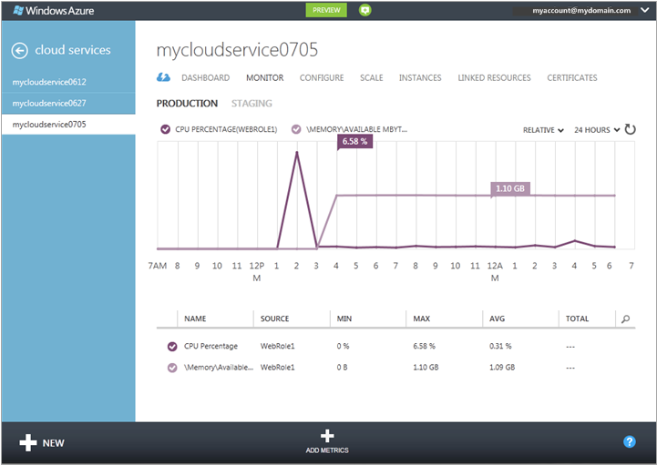
The Classic Portal
The Classic Portal allows you to provision instances of services, infrastructure or apps instantly.
Notes:
20532C
1: Overview of the Microsoft Azure Platform

Slide 20
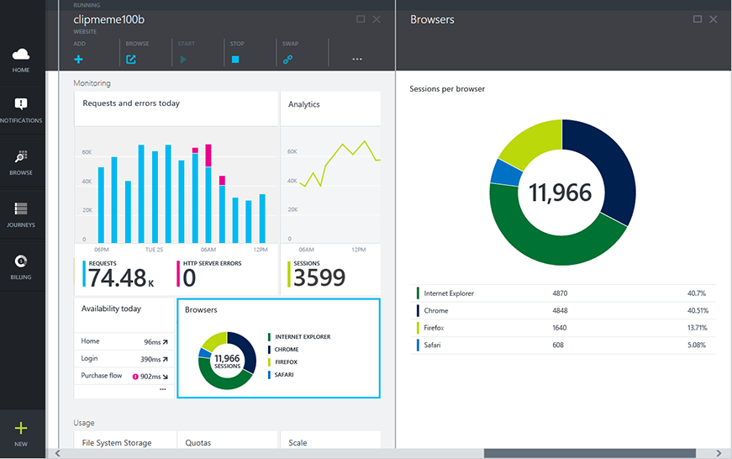
The Current Portal
The latest Azure Portal is designed for DevOps
The portal makes it easy to monitor your services and applications.
Notes:
Do not spend too much time on this slide because the next topic demonstrates the Portal.
20532C
1: Overview of the Microsoft Azure Platform

Slide 21
Current Functionality of the Portal
The list of services and features that are available in the Preview Portal changes rapidly
In this course, you will learn about the following features in the Preview Portal:
Storages
Web Sites
Application Insights
SQL Databases
Virtual Machines
Virtual Networks
Notes:
Currently, the Portal changes every week. Based on the changes, you can edit the list of features on the slide and also perform an extra demonstration, if required.
20532C
1: Overview of the Microsoft Azure Platform

Slide 22
Demonstration: Using the Current Azure Portal
In this demonstration, you will learn how to:
Use the Azure Portal
Notes:
Preparation Steps
20532C
1: Overview of the Microsoft Azure Platform

Slide 23
Portal URLs
Management Portal
https://manage.windowsazure.com
Current Portal
https://portal.azure.com
Each portal can be accessed using a specific URL:
Notes:
20532C
1: Overview of the Microsoft Azure Platform

Slide 24
Demonstration: Switching Between the Portals
In this demonstration, you will learn how to:
Switch to the Management Portal
Switch to the Current Portal
Notes:
This demonstration will be more effective if you have some existing services that you created by using the demo Azure account.
Point out to the students that the terminology for the “Web Sites service has changed. In the current portal, the collection is called Web Sites and an instance is called Web Site. In the new portal, the collection is called Websites and an instance is called Website.
Preparation Steps
In this demonstration, you will view the current Classic Portal and then switch to the Current Portal.
20532C
1: Overview of the Microsoft Azure Platform

Slide 25
Lab: Exploring the Azure Portal
Estimated Time: 15 minutes
Notes:
20532C
1: Overview of the Microsoft Azure Platform

Slide 26
Lab Scenario
You are designated by your team as the individual who will explore the Azure Portal and then train the other team members on how to use the portal. You decided to customize a few features of the portal and create a new service instance.
Notes:
20532C
1: Overview of the Microsoft Azure Platform

Slide 27
Lab Review
Notes:
20532C
1: Overview of the Microsoft Azure Platform

Slide 28
Module Review and Takeaways
Review Question(s) Best Practice
Notes:
Review Question(s)
Question
You are building an iOS and Android application. Your application will need a back-end web service, and you decided to host the service in Azure. What services can you use to accomplish this task?
Answer
There can be multiple correct answers to this question. Students can suggest building a custom service by using a Web API and hosting the service using Azure offerings such as Cloud Services or Virtual Machines. Students can also suggest using the Mobile Services offering.
Best Practice: Many of the services that are covered in this module are pre-requisites for the course. If you never worked with any of services that are mentioned in this module, please take time to review these services before completing the subsequent modules. This will ensure that you are prepared for the later modules in this course.
This is a good time to have a discussion about the services that are mentioned in the first lesson. If a student is not familiar with a service that is mentioned, instruct him or her to read the content that is available on MSDN or the Azure documentation portal to ensure he or she is prepared for the next modules in the course.
20532C
1: Overview of the Microsoft Azure Platform

